Slide 1

1
| 2010 01 08 | CONFIDENTIAL

Slide 2
Midi Techno Git: Distributed Version Control System
Jean Lalande
CTS
2013 03 05

Slide 3
History of Version Control

Slide 4
History of Version Control
Source code is text in a file!
You can keep lots of versions in one file!
Wow! You can version multiple files at once!
1960
1965
1970
1975
1980
1982
Humans can manually keep track of versions of code!
You can each have your own copy checked out!

Slide 5
History of Version Control
The shared repository can be on a remote machine!
Free open source version control hosting!
When you checkout that’s a fork too, and you can do that in public!
1986
1990
1994
1998
2002
2008
Two people can edit the same file at the same time, and it merges what they both did!
You can distribute it all so there’s no central repository!

Slide 6
Git

Slide 7
Let’s create our first project!
mkdir my-git-project
cd my-git-project
git init
touch README.md
git commit -a -m 'First commit'

Slide 8
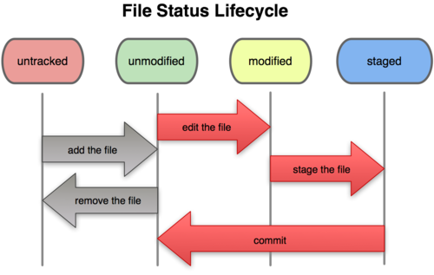
Lifecycle

Slide 9
Let’s clone a project!
https://github.com/jlalande/webapp-demo
git clone https://github.com/jlalande/webapp-demo.git

Slide 10
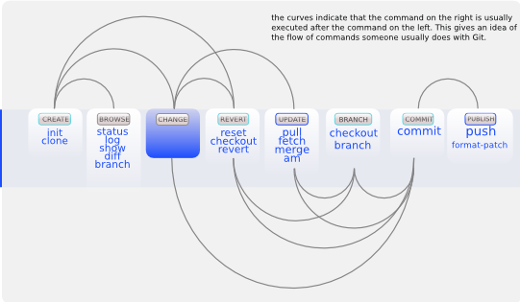
Workflow

Slide 11
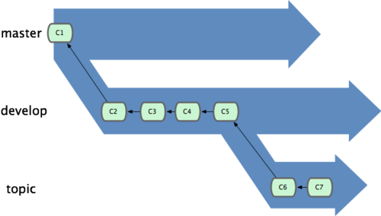
Branching Model

Slide 12
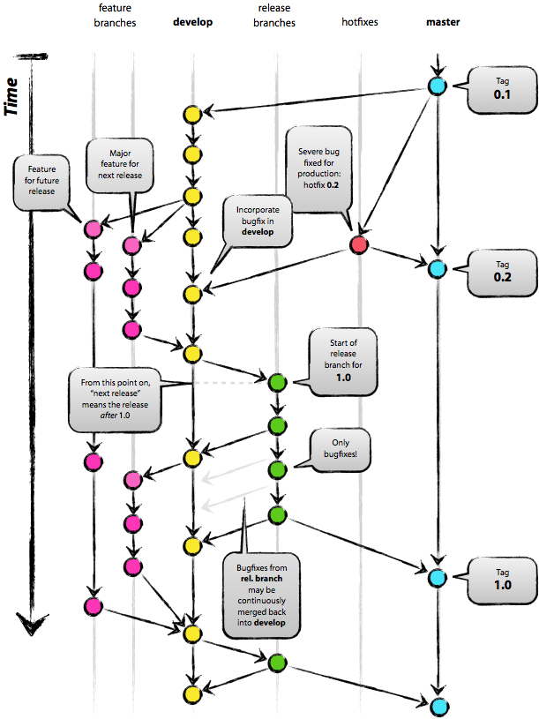

Slide 13
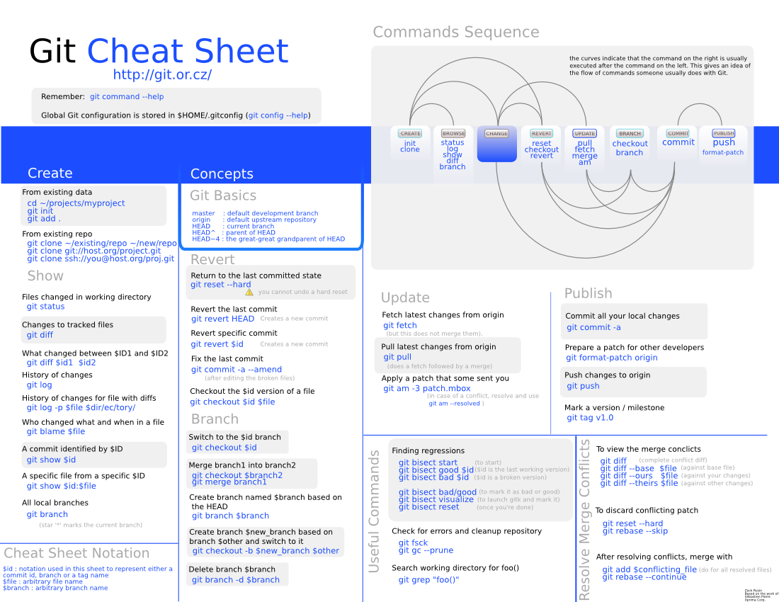

Slide 14
Références
http://git-scm.com/
http://github.com/
http://gitlab.org/
http://nvie.com/posts/a-successful-git-branching-model/
https://code.google.com/p/tortoisegit/
http://zrusin.blogspot.ca/2007/09/git-cheat-sheet.html

